Slide 1
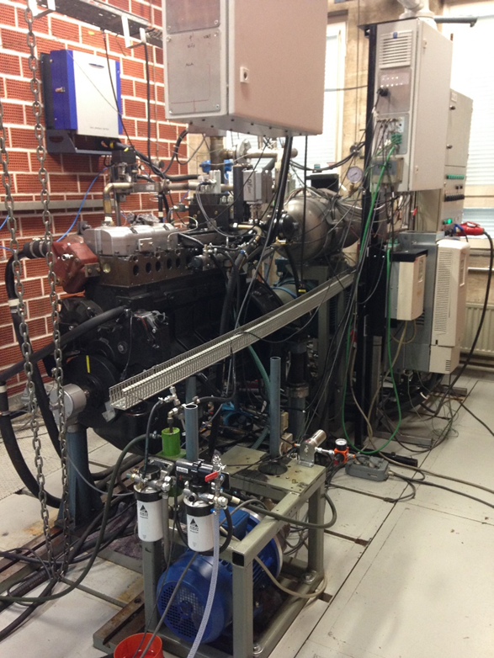
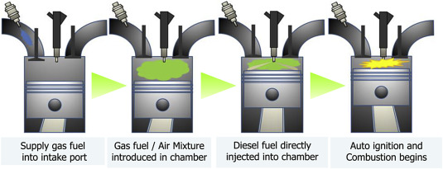
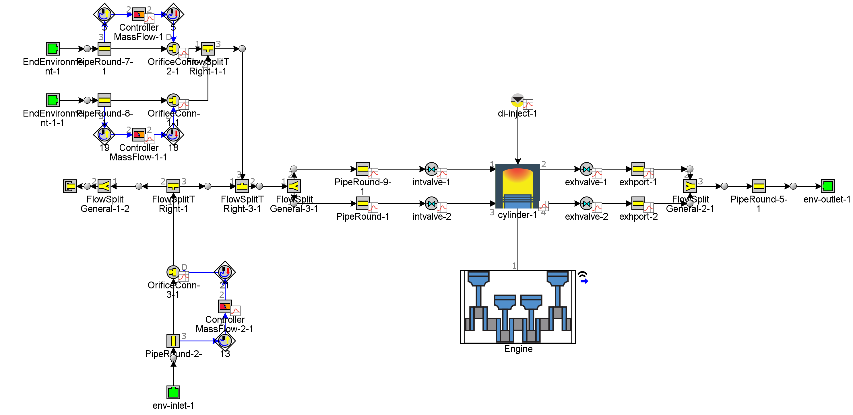
Research Group of Energy Conversion
Department of Mechanical Engineering
Aalto University, Finland
1D Simulation for a Diesel Pilot Dual-Fuel Combustion Engine
Qiang Cheng (Jonny)
Background
Experimental Setup
Concept of the Dual-Fuel Combustion Engine
Engine modelling
1D model for a Dual-Fuel Combustion Engine
Figure 2. Flexible research engine for dual-fuel combustion
An AGCO 84AWI 6-cylinder was modified for single-cylinder research in dual-fuel, which provides possibilities to freely vary all kinds of physical variables. The free control of parameters related to intake, injection, valve actuation, exhaust etc. is made possible by LabVIEW based and custom-made control program that uses Field Programmable Gate Array (FPGA) provided by National Instruments. The engine specifications are listed in Table 1.
Figure 1. 1D model of a single-cylinder compression ignition engine based on GT-Suite
Table 1. Engine specifications
Descriptions of the 1D modelling Tool GT-Suite
Cylinder bore (mm) | 111
Stroke (mm) | 145
Total Displacement- 6-cylinder (L) | 8.42
Displacement 1-cylinder (L) | 1.4
Compression ratio | 16.5:1
Diesel pilot injection | Bosch CRIN3-20 Common rail, direct
Methane injection | Port injection with 2 Hana injectors
Engine control | Custom made in LabVIEW environment, uses NI DRIVVEN and other NI modules
GT-Suite is the market leading engine simulation software, used by every major engine manufacturer for the design and development of their engines.
GT-Suite counts on two main powerful tools called GT-ISE (Integrated Simulation Environment) that builds, executes, and manages the simulation process and, GT-POST, a post-processing tool that provides access to all the plot data generated by the simulation.
GT-Suite solver is based on the 1D solution of the fully unsteady, nonlinear Navier-Stokes equations. Beyond this software core is the thermodynamic and phenomenological model solvers to capture the effects such as combustion, heat transfer or droplet evaporation.
In this project, the GT-Suite will be used to simulate and predict the engine performance with dual-fuel combustion. Meanwhile, the simulation results will compare to the simulation results.
Objective and Outcomes
You will learn how to use the advanced tool to solve practical problems based on the principle of thermodynamics.
You will study how do the different input parameters affect the engine performance in diesel-methane dual fuel (DF) combustion mode.
You will learn how to use 1D simulation tools to predict the engine performance and validate the model based on the experimental results.
After the project, you will know how to create a 1D model for some practical applications, e.g., internal combustion engine, etc.
eng.aalto.fi/en

